Slide 1

A Clean Start with Tidy Eval
Nic Crane
Data Scientist

Slide 2

You should care if:
You write your own R functions
You want to use functions from dplyr (and tidyr) inside your functions

Slide 3
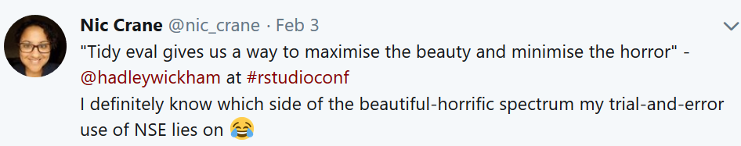
You should care if:
This is also you

Slide 4
Simple?
library(dplyr)
wrangle_data <- function(data, column, val){
data %>%
select(column) %>%
filter(column == val)
}
wrangle_data(iris, "Species", "versicolor")

Slide 5
Nope!
[1] Species
<0 rows> (or 0-length row.names)

Slide 6
“Most dplyr functions use non-standard evaluation (NSE). This is a catch-all term that means they don’t follow the usual R rules of evaluation. Instead, they capture the expression that you typed and evaluate it in a custom way.”

Slide 7
Fix Part 1 - !!
“Bang bang”
Overrides dplyr’s “special” behaviour
“The !! operator unquotes its argument. It gets evaluated immediately in the surrounding context.”

Slide 8
Fixed?
library(dplyr)
wrangle_data <- function(data, column, val){
data %>%
select(!!column) %>%
filter(!!column == val)
}
wrangle_data(iris, "Species", "versicolor")

Slide 9
Nope!
[1] Species
<0 rows> (or 0-length row.names)

Slide 10
Fix Part 2- sym
Converts to a symbol
“Species” -> Species
X
✔
filter(iris, "Species" == "versicolor")
filter(iris, Species == "versicolor")

Slide 11
Fixed?
library(rlang)
wrangle_data <- function(data, column, val){
data %>%
select(!!sym(column)) %>%
filter(!!sym(column) == val)
}

Slide 12
Hooray!
> wrangle_data(iris, "Species", "versicolor")
Species
1 versicolor
2 versicolor
3 versicolor
4 versicolor
5 versicolor
6 versicolor

Slide 13
tidy eval resources
Resource | URL
RStudio tidy eval webinar | https://www.rstudio.com/resources/webinars/tidy-eval/
dplyr programming vignette | https://dplyr.tidyverse.org/articles/programming.html
Edwin Thoen - dplyr recipes | https://edwinth.github.io/blog/dplyr-recipes/
Nic Crane – tidy eval posts | https://thisisnic.github.io/tags/tidyeval/

Slide 14
Thanks for listening!

